Slide 1

CEO report review
--Daily report

Slide 2

Agenda
UI for report
Other for report

Slide 3
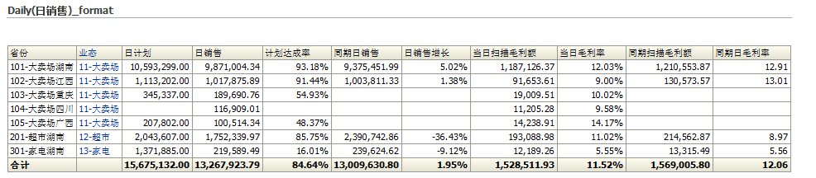
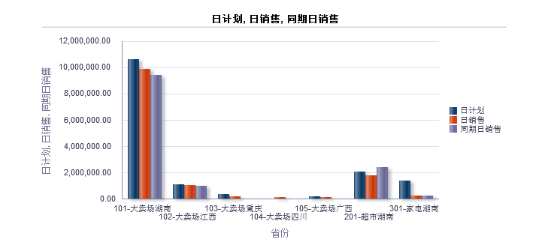

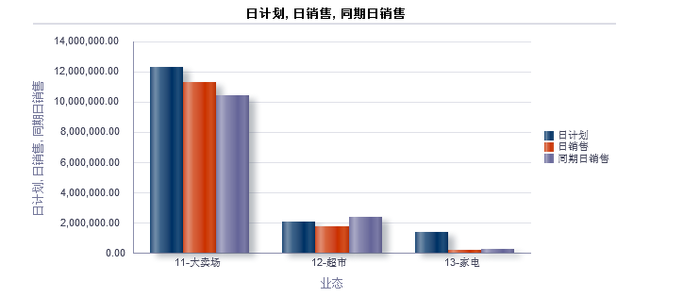
UI for report
UI for table
UI for graph
Notes:
核对2013与2012年的历史数据。不考虑2011年的数据。

Slide 4

Other for report
Diff Dimension
Store category
Item category
Province
Format improvement discussion

Slide 5

Thank you

